Slide 1
The zorro circle

Slide 2
Activity
5 minutes
Record the three things in your life you have most control over…
Record three things you have no control over.

Slide 3
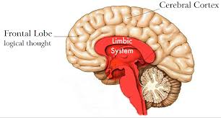
The ‘Thinker’ and the ‘leaper’
Frontal lobe – The ‘Thinker’. Rational. Think, then react
Limbic system – The ‘Jumper’. Animal brain. Fight or flight. The oldest part of the brain.

Slide 4
Zorro’s training
https://www.youtube.com/watch?v=IfjDXMM-yzI
What does Don Diego (The Master) ask Alejandro to do...?

Slide 5
Key learning points
Zorro circle = a metaphor for how we can achieve our ambitions.
ONE OF THE BIGGEST DRIVERS OF SUCCESS = RECOGNISING THAT OUR BEHAVIOUR MATTERS. We have control.
We are masters of our own fate.

Slide 6
The psychology
Question: There many ways of explaining WHY we succeed at something.
What might they be?
Clue – Internal and external

Slide 7
The psychology
“FEELING THAT WE ARE IN CONTROL, THAT WE ARE MASTERS OF OUR OWN FATE AT WORK AND HOME, IS ONE OF THE STRONGEST DRIVERS OF WELL-BEING AND PERFORMANCE”.
This is more about how much control we think we have rather than how much we actually have.

Slide 8
Feelings of control internal or external?
1 – “They don’t recognise my talent, I never had a chance”
2 – “I won because I played well”
3- “I passed because the test was easy”
4 – “I succeeded because the other people weren’t very good”
5 – “They were a great team, that’s why they beat us”
6 – “I can’t do maths, it’s impossible”
7 - “I did loads of revision and that helped”
8 – “I’m just not very good at it! What’s the point trying?”
9 - “I reckon if I put some work in I’ve got a chance”
10 – Anyone want to have a go at making one up?

Slide 9
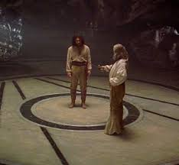
What are the benefits to having an “internal locus of control?”
THE POWER LIES WITHIN THEIR CIRCLE

Slide 10
Feelings of control
Internals:
Higher achievement,
Happier at work,
Higher motivation,
Stronger relationships.
Externals:
Helplessness,
Events driven be “external forces” outside their “Zorro” circle.

Slide 11
Psychological evidence
2002 study – 3000 employees. Greater feelings of control at work =
greater job satisfaction, relationships, family life,
Elderly people in a nursing home. More control over simple tasks: in charge of their own plants, helping to cook at mealtimes etc =
Level of happiness increased, live longer!

Slide 12
Psychological evidence
7,400 employees who felt little control over deadlines imposed by other people =
Higher risk of coronary heart disease than others
When the “Thinker” wins against the “Jumper”.
The danger of “Reach for The Stars”.

Slide 13
Summary of research
“Don’t write a book… write a page”.
Small, manageable goals
INTERNAL locus of control is preferable

Slide 14
The danger of “reach for the stars”…
Frontal lobe – The ‘Thinker’. Rational. Think, then react
Limbic system – The ‘Jumper’. Animal brain. Fight or flight. The oldest part of the brain.

